Slide 1

Designing simple web
Application in Spring Boot
Kinga Gniadek, Łukasz Kutrzuba 07-12-2022

Slide 2



Before we start …
Kinga
Participated in Women In Tech Camp in 2017 , where decided to apply for internships at Ericsson,
Now works as Senior Software Developer responsible of automation in one of Ericsson’s QAs,
Main technology used at work: Java.
Łukasz
Has been working at Ericsson for 9 years,
Senior Software Developer responsible of automation in one of Ericsson’s QAs,
Main technology used at work: Java.

Slide 3
Content of presentation
1
Functional specification
General Info
Roles
Items/Objects in System
Use Cases
Scenarios
Limitations
Forms/Views
2
Implementation - Backend
Technologies used
Spring Boot – what is it?
Database schema
Database – Hibernate & MySQL
REST methods
Spring Security
3
View - Frontend
Technologies used
Thymeleaf
Bootstrap
JQuery
4
Questions

Slide 4

GitHub
In case if you will be interested in topic after this training
– you can find Presentations and Application on GitHub
https://github.com/lukaszkutrz/my_first_app_in_springboot
Presentations and code will be updated till the end of this week
(I ve just invented some new ideas of small improvements)
Source code of application Book Rental,
Additional presentation describes how to configure environment and run the application,

Slide 5

Functional specification

Slide 6

General information
Book Rental is a web application written using Spring Boot, Hibernate & Thymeleaf.
Book Rental is designed for librarians, and it is supposed to be used in small libraries. It helps with managing the process of renting books to readers.
Application is designed to be simple and not complicated. Many features are simplified.

Slide 7
Before we start designing technical aspects of our application, we need to get to know our system.
We need to think about what our program should do.
We need to think about real-world problems that are supposed to be solved by our app.
Without gaining the knowledge about the domain our application will not be effective!

Slide 8


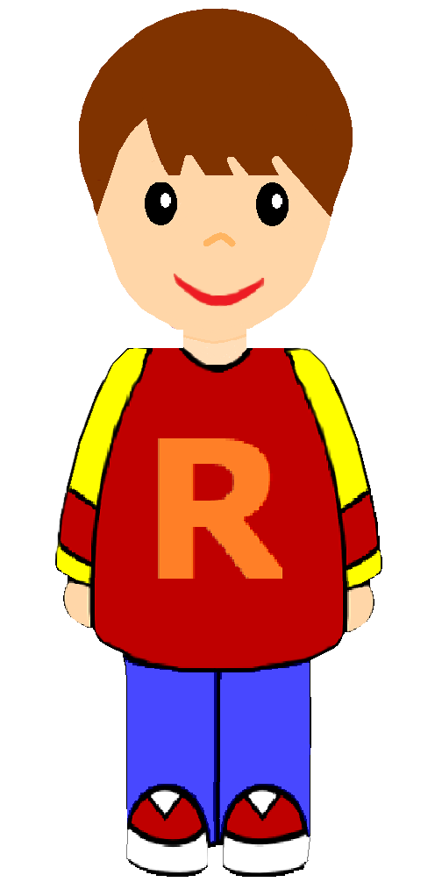
User Roles
Librarian
Reader

Slide 9
Librarian
Registering the new users,
Adding new books,
Editing data about books / readers,
Renting books to users,
Checking how many books are rented by particular user,
Handling returned books in system.
Librarian

Slide 10
Reader
Searches available books in Library,
Checks which books are currently rented by him.
Reader

Slide 11
Items / Objects in system

Slide 12


Real–world objects
Library Card ID
123456
Book ID 379234
Library card ID
Book
RENTED

Slide 13
Book
Usually inside any library we have many books on the shelves,
Each book has unique book ID,
Each book has title and author.
Book ID 379234

Slide 14
Book
Other important properties are ISBN and year of publication,
Book can have a few categories (for example: novel, romance, horror, fantasy, science-fiction…),
Finding a particular book in big store might be difficult. To help Librarians with this task we added field shelf. This field represents physical location of book in library building.
Book ID 379234

Slide 15
Library card
Each user registered in library gets the printed document: “Library Card“,
Each Library CARD has unique ID,
The same ID is used in our system. Book Rental application identifies users by Library CARD ID.
Library Card ID
123456

Slide 16
Use cases

Slide 17
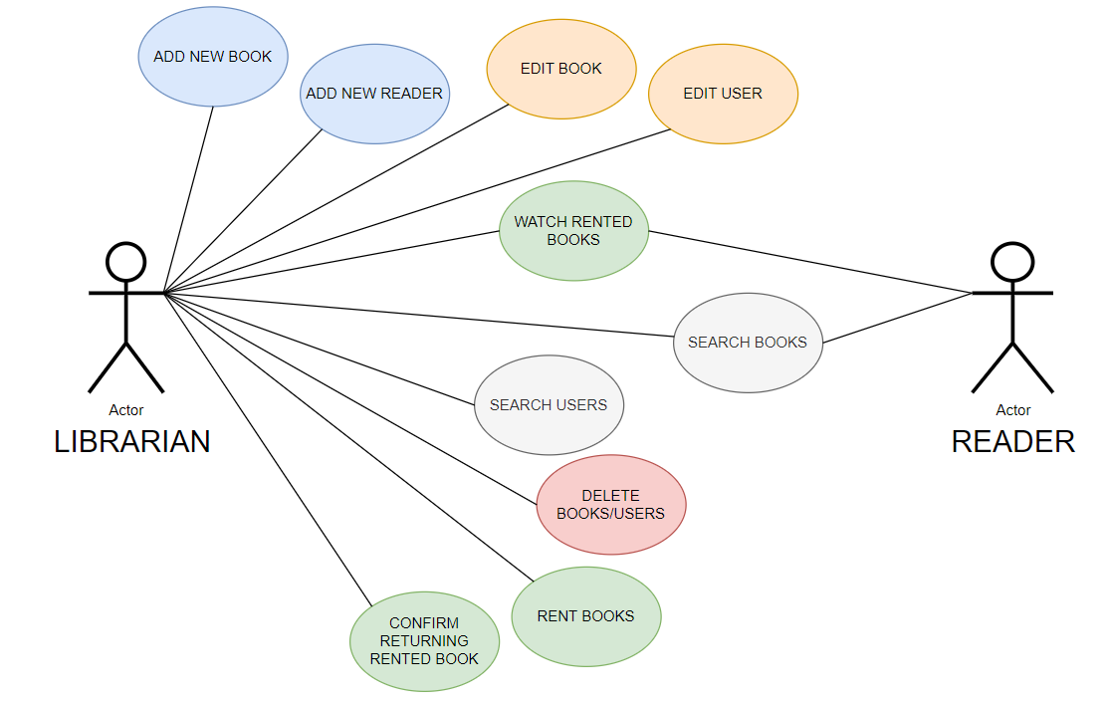

Slide 18
Scenarios

Slide 19
Yellow – activities in "real world", for example putting book on the shelf
White – virtual activities in Book Rental application

Slide 20
Scenario 1: Library bought a new book
<<INSIDE LIBRARY>>
Librarian puts the new book on the shelf.
Librarian starts the Book Rental application, logs in and clicks “Add New Book” button.
Librarian fills in the form and confirms operation. Book is added to the system.
Book ID 379234
Librarian

Slide 21
Scenario 2: New reader came to the library
<<INSIDE LIBRARY>>
New Reader arrived. The person wants to join library.
Librarian starts the Book Rental application, logs in and fills in the form “Add New User”. Unique ID is generated.
Library CARD ID is printed by Librarian. Document is given to the user.
Library Card ID
123456
Librarian
Reader

Slide 22
Scenario 3: Reader wants to rent a book
<<INSIDE LIBRARY>>
Reader comes in into the library building. Guest informs librarian about the book he wishes to rent.
Librarian searches book in System. The book is available.
Librarian takes the book from the shelf.
Librarian registers renting book in the system using ID of Library CARD showed by user.
Library Card ID
123456
Librarian
Reader
c

Slide 23
Scenario 4: Reader comes to library and returns book
<<INSIDE LIBRARY>>
Reader comes in into the library building and returns the book.
Librarian searches book in System and registers that the book is back.
Librarian puts the book on the shelf.
From now on other readers might borrow this book.
Library Card ID
123456
Librarian
Reader

Slide 24
Scenario 5: Pile of returned books, readers already left
<<INSIDE LIBRARY>>
In the morning many readers came to the library building. Librarian was very busy...
In meanwhile a few readers put their books on the table and left the library.
Now, we have a pile of returned books,
One by one book, Librarian opens the books and finds the rubber stamp with book id,
For each book librarian finds record in the system under "Rented Books" and clicks "Return Book" button.
Librarian

Slide 25
Scenario 6: Reader logs in to Rental App from home,
<<ONLINE>>
Reader needs certain book for his university work.
Reader logs in to the system,
Reader goes to "Search Book" and types the query.
System displays the information about the desired book.
Book is available in the library and not rented, so user will visit the building in person,
Reader

Slide 26
Limitations
c

Slide 27

Limitations
Application can be used in libraries, so it is designed to be run on Laptops/Computers,
Application is NOT supposed to be used on cell phones.
c

Slide 28

Limitations
Application is designed to be simple and not complicated. Many features are simplified,
Application was designed for training purpose.
What is simplified?
- no registration and same password for each user with the same role
- no limit of books and no due date for rentals
c

Slide 29
Limitations – what is missing?
There should be a limit of books that could be rented by one user at a time (also, zero books should exceeding the deadline). No renting possible for person that is breaking the rule.
Each rent should have the starting date and expected date of returning (30 days). The return date for the rented the book can be postponed by Librarian.
Book Reservations by readers, they can be made online – no need to arrive to library. Reserved book cannot be rented.

Slide 30
Limitations – what is missing?
Real login and registration handling– so far, our application uses simplified login page with pre-defined passwords, roles for all users are granted on application start,
Users should be able to login to system immediately after they were added (for now it requires the restart of application),
Lack of support for more than 1 copy of certain book – user needs to add two or more identical books. This should be improved,

Slide 31
Forms / Views

Slide 32
It is high time for designing the forms/subpages of our app,
To complete this task we can:
use wireframing (there are many applications on web that helps us with it),
or simply draw/sketch our forms on paper,

Slide 33
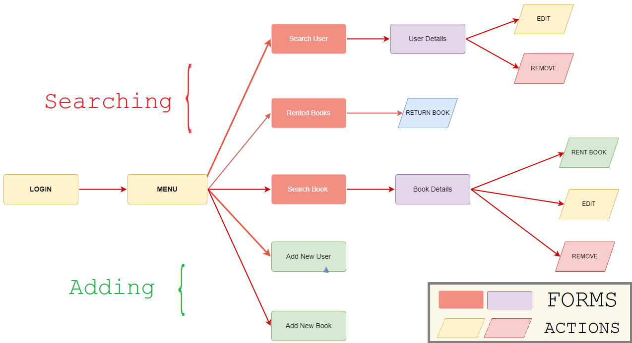

Slide 34
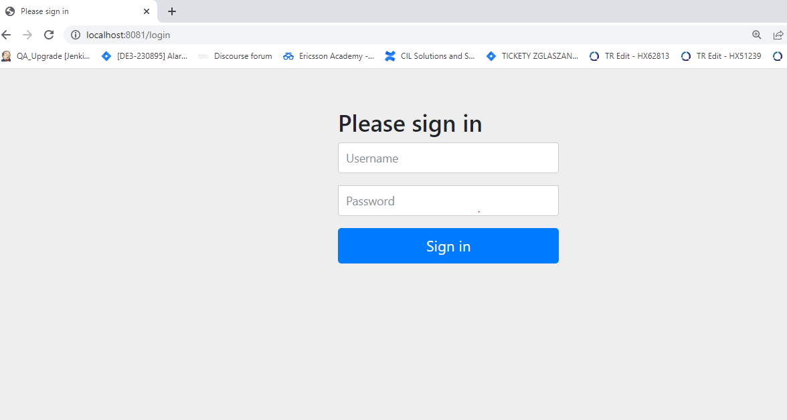
[K]
c

Slide 35
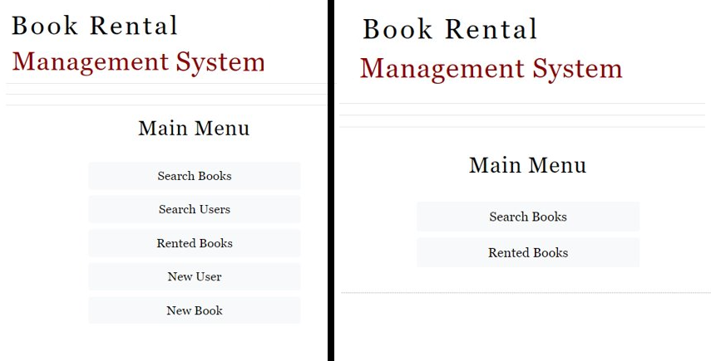
Menu for Librarian vs Menu for Reader

Slide 36
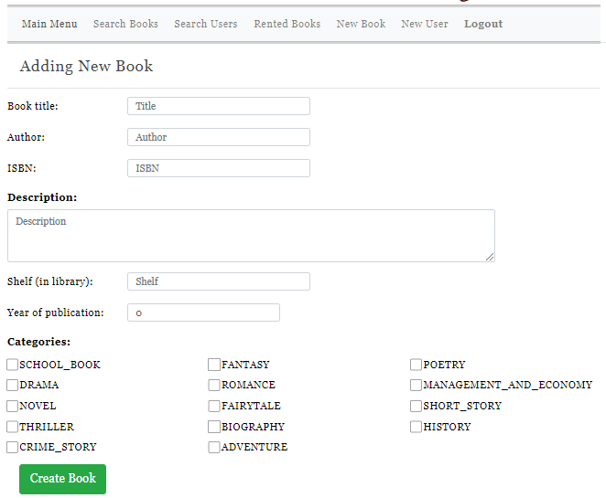

Slide 37
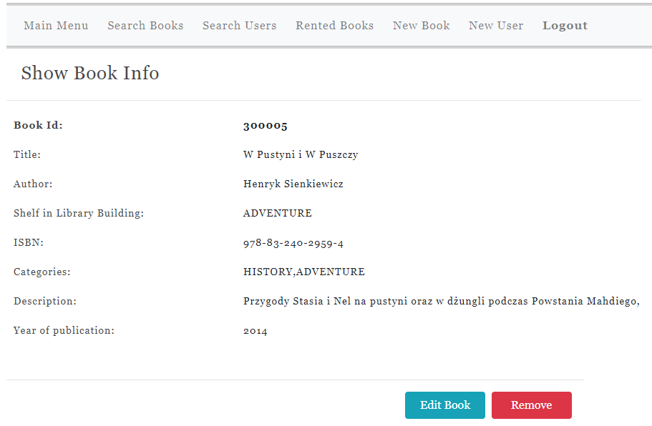
c

Slide 38
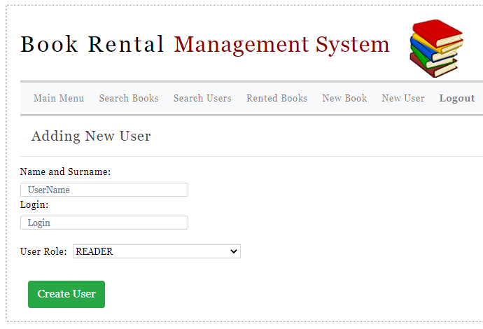
c

Slide 39
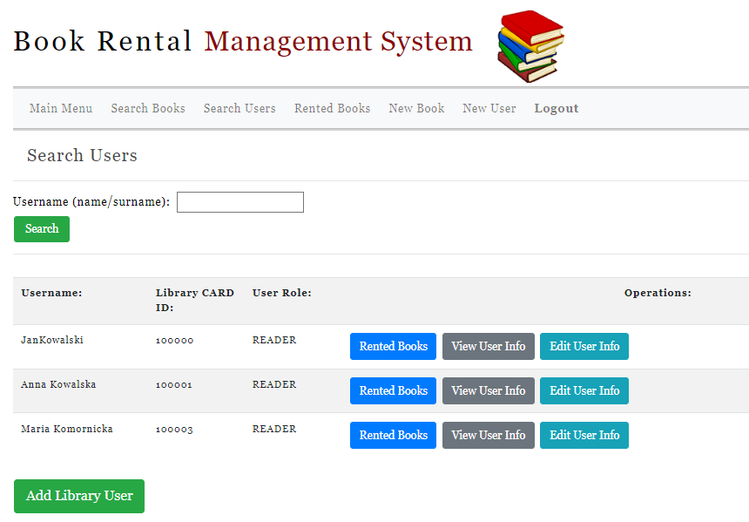
c

Slide 40
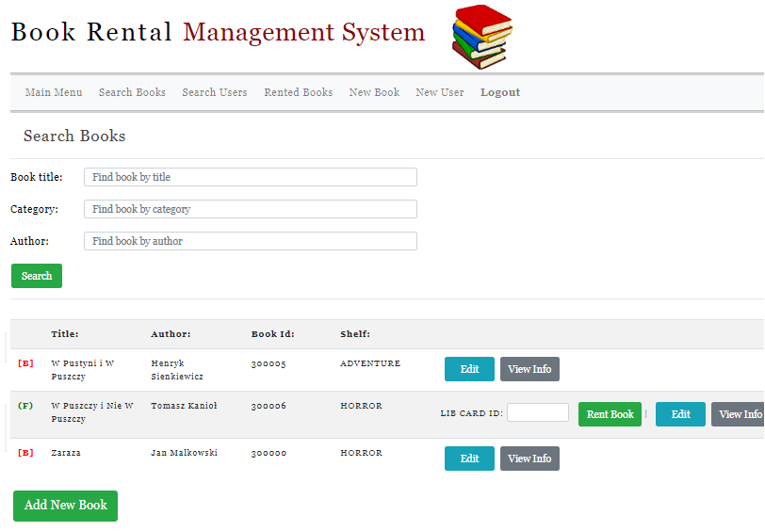
c

Slide 41
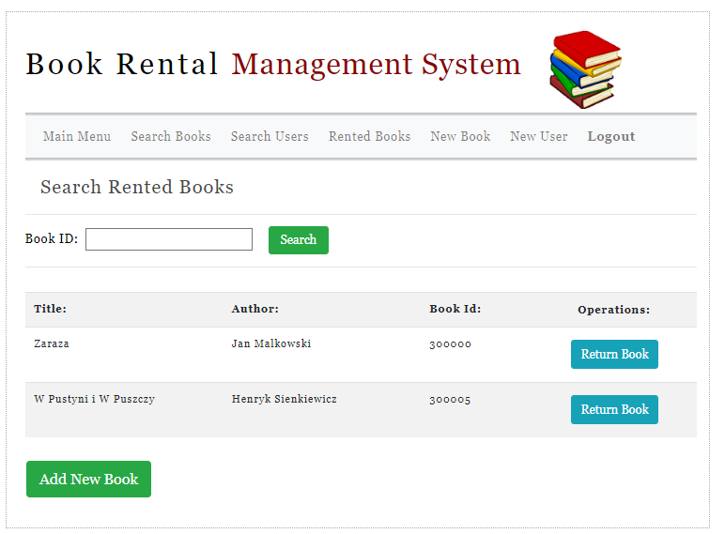
c

Slide 42
<< IT ' S SHOWTIME >>
Book Rental Application
c

Slide 43
Implementation

Slide 44
In the previous chapter we discussed the functional specification of our app.
Now, we know what our system does, so we can proceed to designing technical aspects of it,
We will discuss the following aspects:
- backend technologies,
- database schema,
- structure of the project,
- frontend technologies,

Slide 45
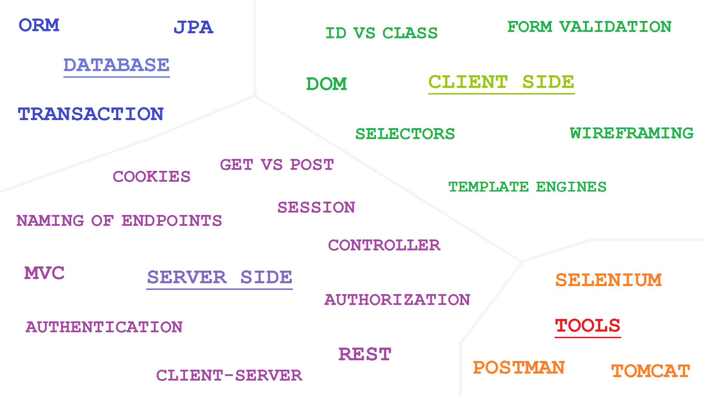

Slide 46
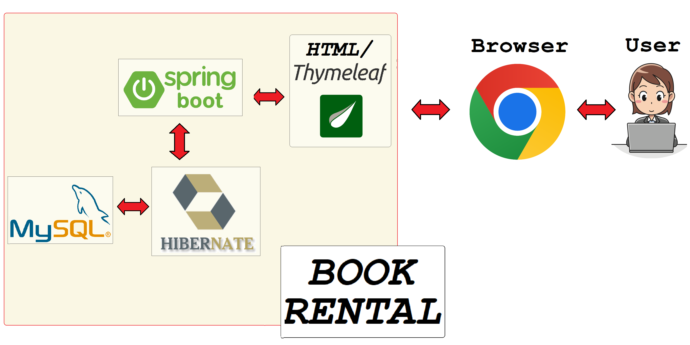

Slide 47
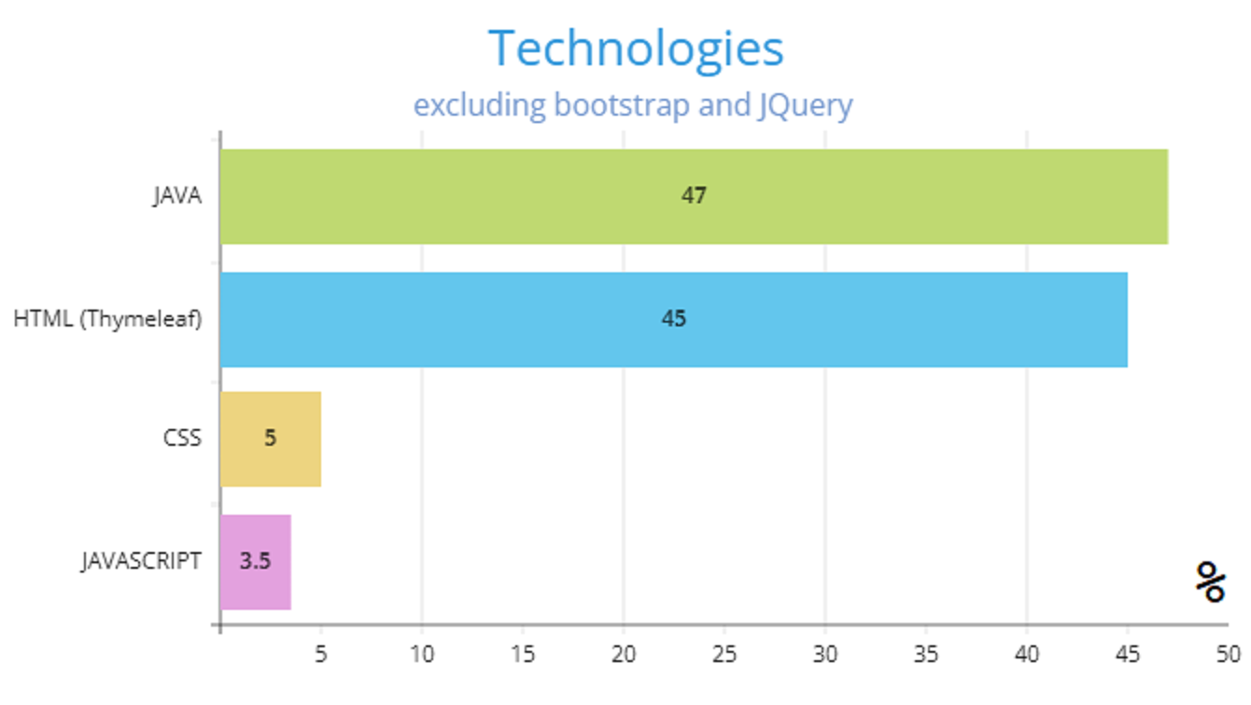

Slide 48

Implementation - Backend

Slide 49






Technologies used for backend

Slide 50
General Idea of Project – Make Our Lives Easier!
No need to manually add dependencies to pom - we can use Spring Initializr and choose desired components,
We are not creating tables/relations - Hibernate is doing this for us automatically,
We are not installing Tomcat Server to run web app - it is already included in Spring Boot,
As for Authentication/Authorization, for example preparing login page and displaying certain things for certain roles – Spring Security is helping us heavily!

Slide 51
<< IT ' S SHOWTIME >>
Initializr

Slide 52
Spring boot – what is it?
Open-source java-based framework used to create micro-Services,
We can start our work with minimum configuration -> Spring boot initializer ,
No need for installing server – tomcat is already provided,
Easy to understand, lots of free tutorials available,
Using Spring Boot, we can eliminate most of the boilerplate configuration.
We can create our applications much easier/faster!

Slide 53
Spring boot – what is it?
Spring boot provides:
flexible way to configure Java Beans, xml configurations
and database transactions,
Powerful batch processing & managing REST endpoints,
Auto configuration – no manual configurations needed,
Annotation-based application,
Easy dependency management,
Included Embedded Servlet Container,
Security library – handling logging (includes default forms), integration with Thymeleaf.

Slide 54
Database schema

Slide 55
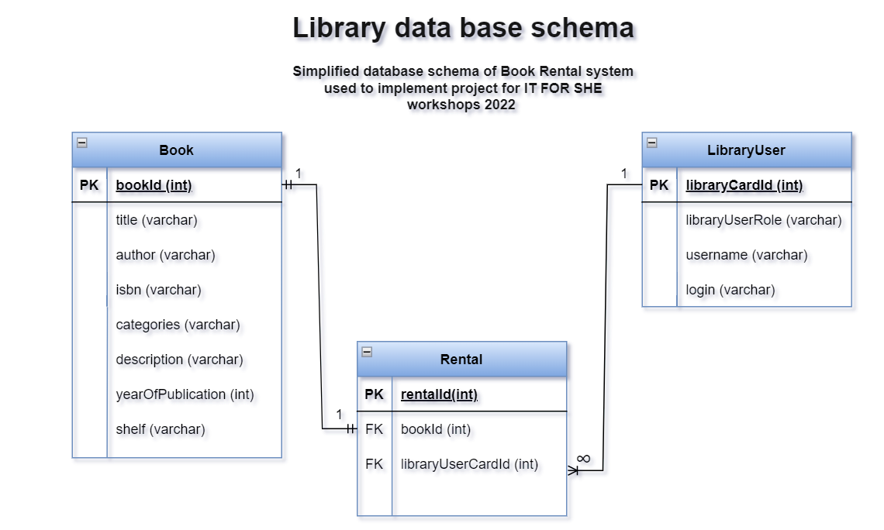

Slide 56
Database –Hibernate & MySQL
Hibernate is:
One of the most popular implementation of JPA (Java Persistent API),
Object relational mapping (ORM) tool providing a framework to map object-oriented domain models to relational databases for web applications (maps java classes into database tables and java data types to SQL data types and provides querying and retrieval).
Benefits of using hibernate:
Open-source,
Database type independent – connectors available for any database like Oracle, MySQL, PostgreSQL etc
Automatic table creation – no manual work in database needed,
Handling database creation if it does not exist,

Slide 57
Database – Hibernate & MySQL
Benefits of using hibernate:
Transparent persistence – ensures the automatic connection between application’s objects with the database tables,
HQL (Hibernate Query Language) – object-oriented version of SQL generating database independent queries,
Easier data fetching from multiple tables.

Slide 58
Database –Hibernate & MySQL
Prerequisites:
MySQL (or any other database you want to use) needs to be installed on your computer,
Under resources there must be application.properties file defined,
In properties file we define e.g., URL of database source, type of connector, credentials to access database,
Proper connector and hibernate related dependencies must be present in pom.xml.

Slide 59
Database –Hibernate & MySQL
Annotation for model classes:
All java classes that shall be converted to tables need to be annotated with @Table,
Java fields of mapped classes need to have annotation @Column,
For Primary Key (PK) we can use autogenerated ID within annotations @Id and @GeneratedValue,
Relations between tables (FK) are annotated by @ManyToOne, @OneToOne, @OneToMany, @ManyToMany tags.

Slide 60
MVC
Model View Controller (MVC) – design pattern that specifies that an application is split into model, presentation information and control information. It requires that each mentioned part is separated into different object.
GETS DATA
Controller
[supervision of requests]
GETS DATA
INITIATES
VIEW
MODIFIES/UPDATES
DATA
UPDATES
DATA
SETS DATA VIA SETTERS
View
[templates]
Model
[database]
Notes:
Advantages – separation of backend and frontend – easier maintenance, easier to update components independently
In application as model we have classes prepared within hibernate -> Book, Booking, LibraryUser – src.main.java.library.model
Controllers have been defined per each model class – inside there is information how to handle each get/post/update requests, what is the mapping etc. – see package src.main.java.library.controller
As view we have thymeleaf templates – src.main.resources.templates

Slide 61

Spring Boot vs Spring MVC
MVC pattern-based framework for building web applications,
Requires lots of configurations – e.g., for DispatcherServlet and View Resolver,
Every dependency needs to be specified separately for the features to run.
Most widely used framework in the REST API development field. Developed on top of conventional Spring framework. Used for stand-alone web spring applications,
Auto-configuration
Concept of predefined app skeletons – once it is added to the class path, all needed dependencies are brought for development.
Notes:
Only few mentioned – there are more of course ☺
Less configuration = less development time, less manual work, Spring boot is much comfortable to use

Slide 62
REST methods - overview
REST (Representational State Transfer) - an architectural style defining constraints to be used for web services.
REST principles:
Uniform interface,
Client – server separation,
Stateless,
Cacheability,
Layered system,
Code on demand.
REST != HTTP

Slide 63
REST methods - overview
Example REST methods:
GET – fetch data from database – e.g., show details for certain book or search book by title,
POST – add new data to database – e.g., new book in library,
PUT – update information in database – e.g., edit data for certain library user,
DELETE – remove data from database – e.g., delete library user.

Slide 64
REST URLs/Endpoints naming – Nouns,
Our application is NOT fully RESTFUL, but we follow the guidelines to some extent:
URL / ENDPOINT | HTTP METHOD | ACTION
/users | GET | List with many users,
/users | POST | Adding new user,
/users/{id} | GET | Details page for one user having certain ID,
/users/{id} | PUT | Updating one user having certain ID,
/books | GET | List with many books,
/books | POST | Adding new book,
/books/{id} | GET | Details page for one book having certain ID,
/books/{id} | PUT | Updating one book having certain ID,
/rented-books | GET | List with many books that are rented,
/books-rented-by-user/{userId} | GET | List with many books rented by certain user (user has certain userId)

Slide 65
Spring security in backend
Spring Security is a framework that supports authentication / authorization / access-control.
Authorization is any mechanism by which a system grants or revokes the right to perform some action or access some data.
Authentication – who are you?
Authorization – what are you allowed to do?

Slide 66
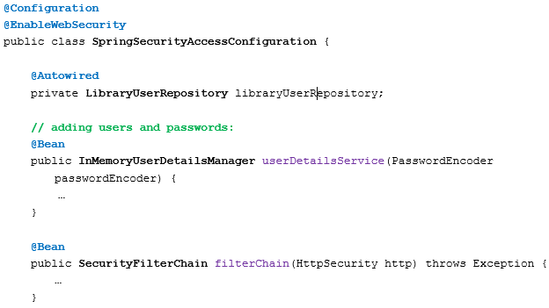
Spring security in backend

Slide 67
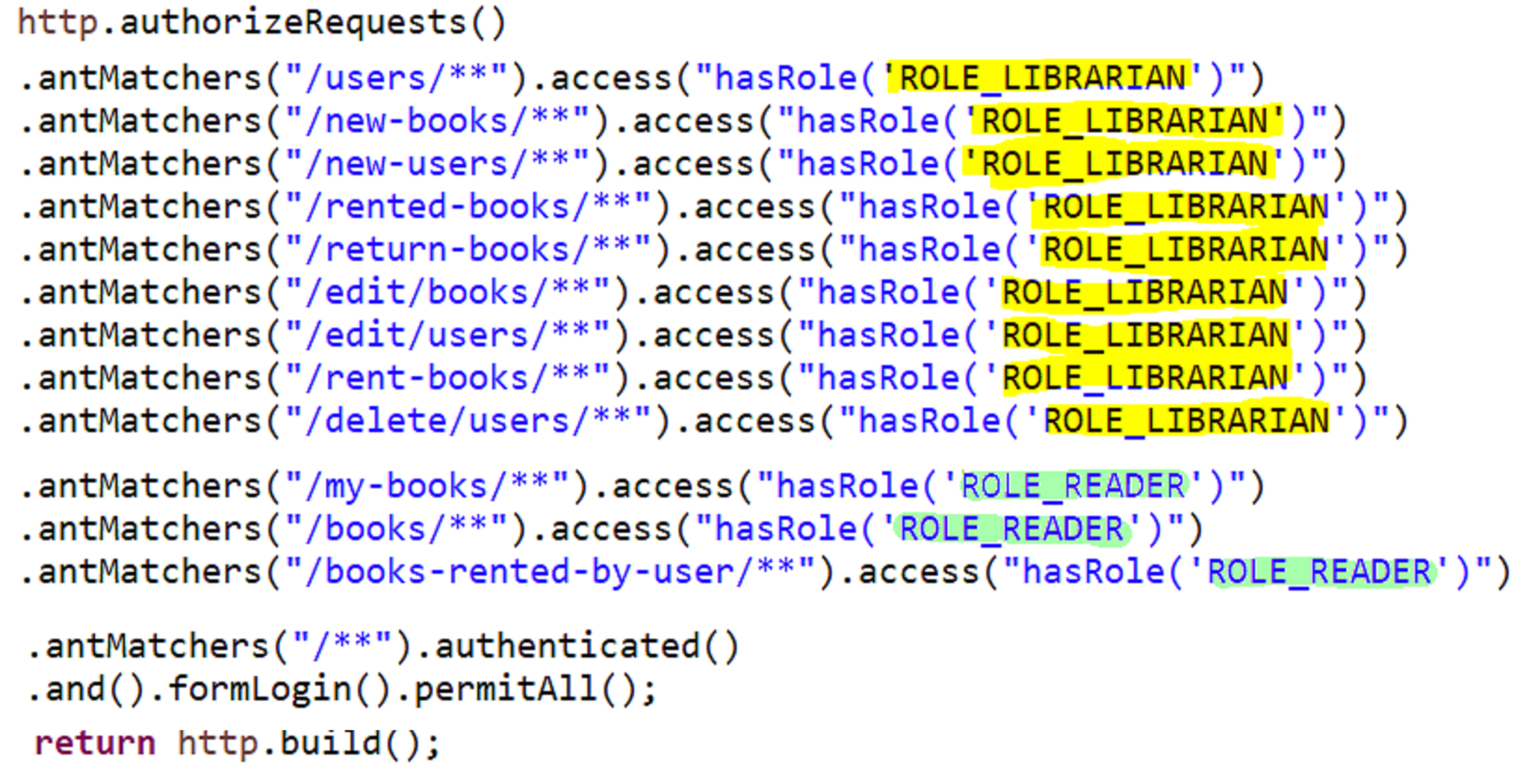
Spring Security

Slide 68
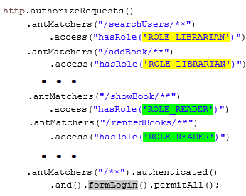
Spring security in backend
Only users with Librarian role can access this .
Users with Reader role can access this (but in our application each Librarian has both roles – this is up to your config).
All users should be able to reach login page.

Slide 69
<< IT ' S SHOWTIME >>
Project’s Structure

Slide 70
<< IT ' S SHOWTIME >>
Database & Model
Controllers
Thymeleaf (VIEW)

Slide 71

View - Frontend

Slide 72





Technologies used for frontend

Slide 73
Thymeleaf – what is it?
open-source server-side Java template engine for both web and standalone environment. It processes and creates HTML, XML, JavaScript, CSS and text. It provides full integration with Spring Framework.
Thymeleaf templates look similar to normal HTML format (much more similar than for example older JSP)
It is compatible with HTML and supports variable expressions (${...}) like Spring Expression Language and executes on model attributes, asterisk expressions (*{...}) execute on the form backing bean, hash expressions (#{...}) are for internationalization, and link expressions (@{...}) rewrite URLs.

Slide 74
Thymeleaf – form methods
- as it is an engine that supports HTML, we must remember that it supports only GET and POST methods. Due to that restriction if we want to use PUT/DELETE methods within Thymeleaf we need to add extra property to application.properties file:
spring.mvc.hiddenmethod.filter.enabled=true
HiddenHttpMethodFilter allows Thymeleaf to use PUT/DELETE.
If you have in form th:method=”put”, then Thymeleaf will use post as the actual method on the form and insert an extra hidden input _method with the preferred HTTP method
Source article

Slide 75
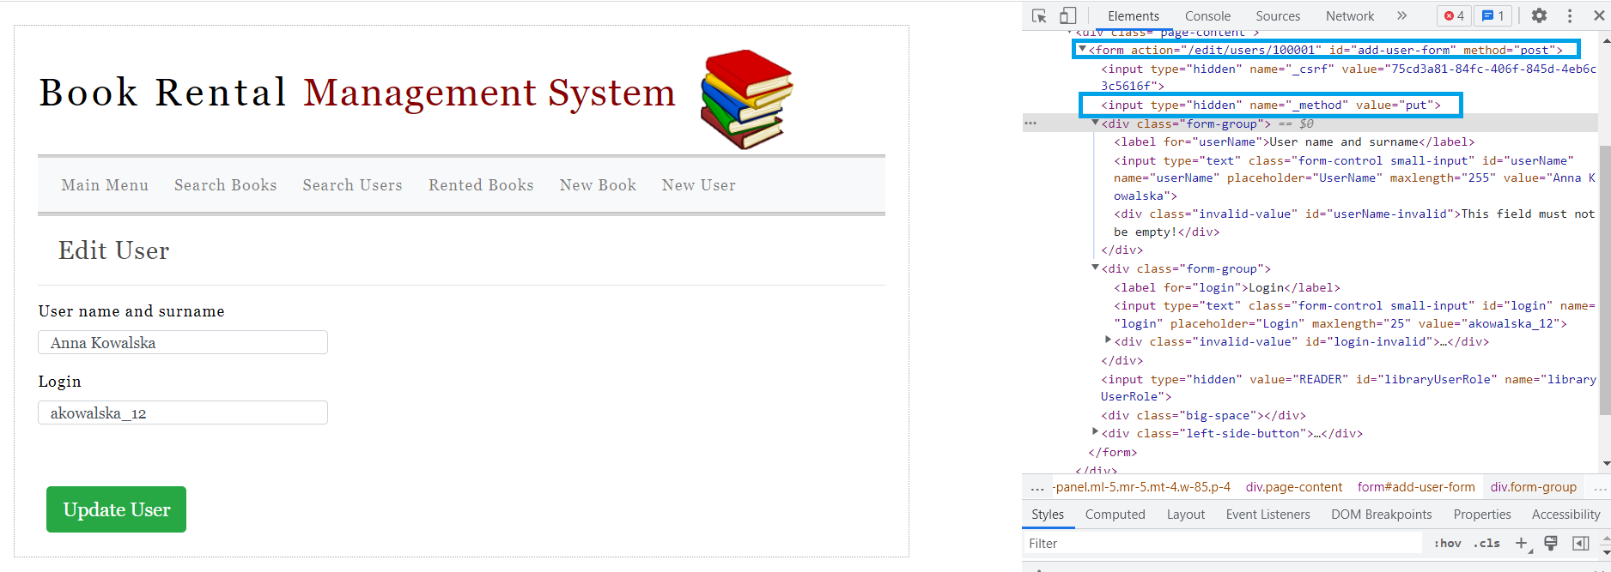
Thymeleaf – PUT form example

Slide 76
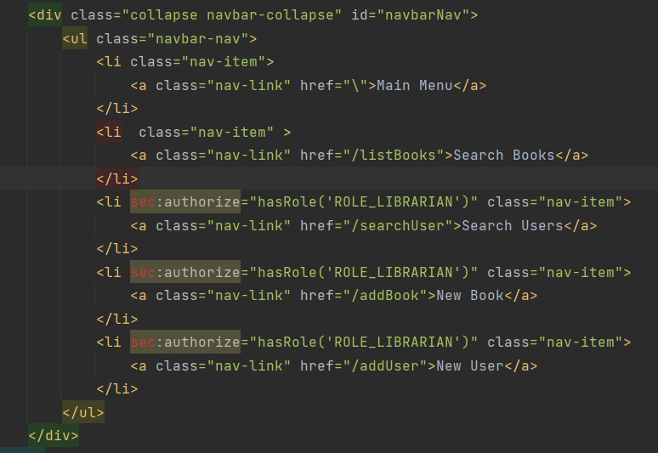
Thymeleaf integration with Spring Security
Integration with Spring Security allows to check if user is authenticated and handle displaying given elements in the form based on user’s roles.

Slide 77
Bootstrap
is open-source front-end development framework for the creation of websites and web apps.
Bootstrap simplifies creating responsive, mobile-first front-end programs.
Bootstrap help us with appearance of our applications.
Bootstrap uses HTML, CSS, and JavaScript.
Bootstrap has ready solutions for many elements: buttons, alerts, modals, tabs, navigation bars, toolkits, dropdowns and many more…

Slide 78
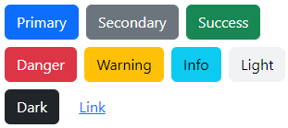
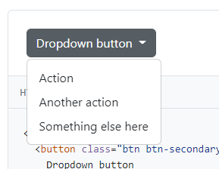
Bootstrap

Slide 79
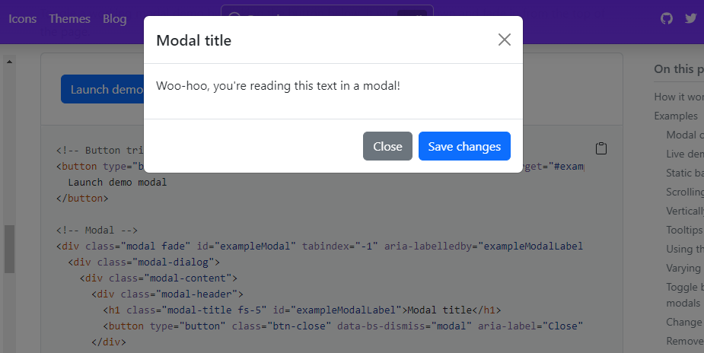
Bootstrap

Slide 80

JQuery
is a feature-rich JavaScript library.
It simplifies operations like: manipulation of HTML document (DOM operations), animations, event handling, AJAX.
Usually, no changes in HTML tags are required.
In our Book Rental application JQuery helps us with form validation on client side.

Slide 81
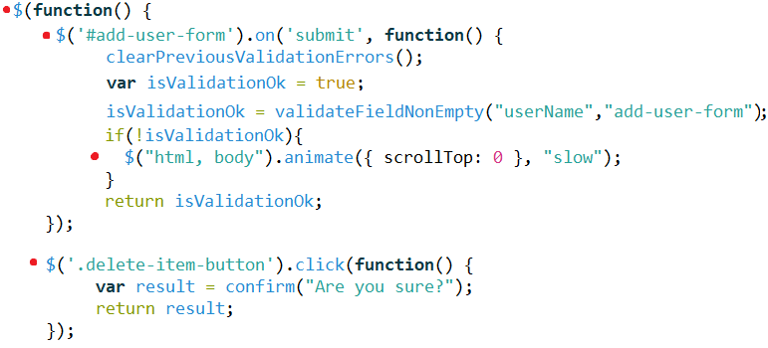
JQuery example

Slide 82
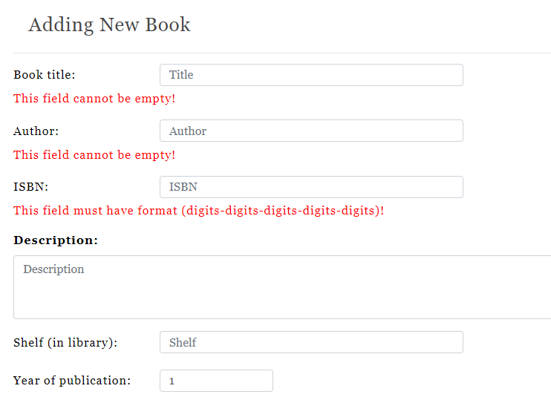
JQuery validate form

Slide 83

Questions

Slide 84
Bibliography
Images:
https://publicdomainvectors.org/pl/wektorow-swobodnych/Grafika-wektorowa-budynku-szko%C5%82y/11750.html
https://openclipart.org/detail/314949/librarian-2
https://freesvg.org/books
https://images.rawpixel.com/image_800/czNmcy1wcml2YXRlL3Jhd3BpeGVsX2ltYWdlcy93ZWJzaXRlX2NvbnRlbnQvbHIvam9iNjczLTE1OS14LmpwZw.jpg?s=l3MJkiQKcO5Q1lqiFPEpZn-HyL-CZmKAjsEnk9XR1bA
https://openclipart.org/detail/298193/librarian
https://freesvg.org/female-computer-user-vector-icon

Slide 85
Bibliography (2)
https://www.interviewbit.com/blog/difference-between-spring-mvc-and-spring-boot/
https://www.freecodecamp.org/news/the-model-view-controller-pattern-mvc-architecture-and-frameworks-explained/
https://www.wimdeblauwe.com/blog/2021/09/23/todomvc-with-spring-boot-and-thymeleaf-part-2/
https://www.thymeleaf.org/
https://www.baeldung.com/thymeleaf-in-spring-mvc

